Slide 1
OptNet: Differentiable Optimization as a Layer in Neural Networks
Brandon Amos and J. Zico Kolter Carnegie Mellon University School of Computer Science
ICML 2017

Slide 2
Big picture
What are the “atomic operations” or building blocks of modern AI systems?
View of the current situation: Matrix-vector products (dense or sparse/structured), (sub)differentiable non-linear functions, random sampling
This talk: We should consider (convex) optimization as another potential layer, to be composed with others
Note: we already use optimization in the learning procedures, but we should also consider it as an operation for inference and control

Slide 3
Optimization in deep learning
Recently there has been a lot of work in applying more generic optimization methods within deep learning architectures
Approach 1: Unroll an optimization procedure (like gradient descent) as a network itself (Domke, 2012; Goodfellow, 2013; Maclaurin et al., 2015; Belanger and McCallum, 2015; Andrychowicz et al., 2016; Metz et al., 2017; Gregor and LeCun, 2010)
Approach 2: Directly differentiate through the argmin (Bradley and Bagnell, 2009; Mairal et al., 2012; Gould et al., 2016; Johnson et al., 2016; Amos et al., 2016; Barron and Poole, 2016)
We’re going to use this approach, but consider a bit more general setting and efficient backpropagation algorithms
Notes:
Revisit

Slide 4
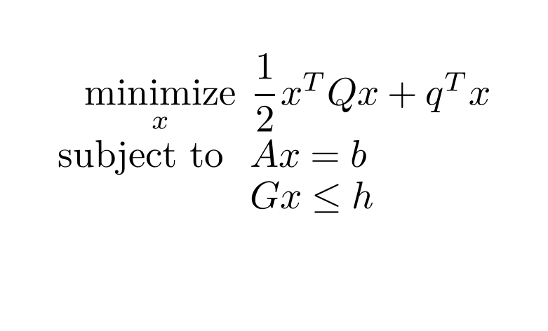
Optimization as a “primitive”
Optimization problems are an extremely powerful paradigm for decision-making
Example: quadratic program
Applications in finance (Markowitz portfolio optimization), machine learning (support vector machines), control (linear-quadratic model predictive control), geometry (projections onto polyhedra)
$$\underset{x}{minimize}{\frac{1}{2}}x^{T}Qx+q^{T}x \\ subject to Ax=b \\ Gx≤h$$
Notes:
Emphasize apps more

Slide 5


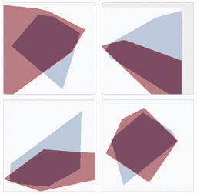
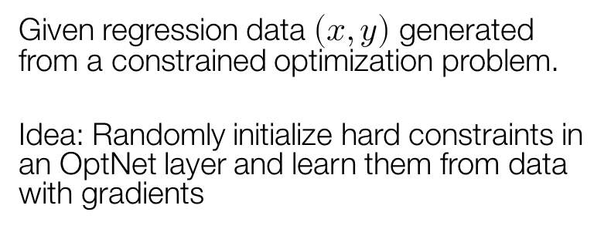
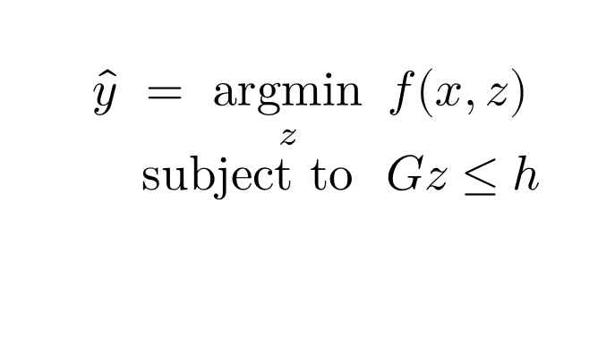
Illustrative Example: Learning Hard Constraints
True constraints (Unknown to the model)
Given regression data $\left(x,y\right)$ generated from a constrained optimization problem.
Idea: Randomly initialize hard constraints in an OptNet layer and learn them from data with gradients
Model’s constraint predictions during training
$$\hat{y} = \underset{z}{argmin}{f(x,z)}$$ $subject to Gz≤h$

Slide 6
Talk Overview
Our contribution: OptNet layers
qpth: Our efficient and differentiable PyTorch QP solver
Experiments
MNIST
1D Signal Denoising
Mini-Sudoku

Slide 7
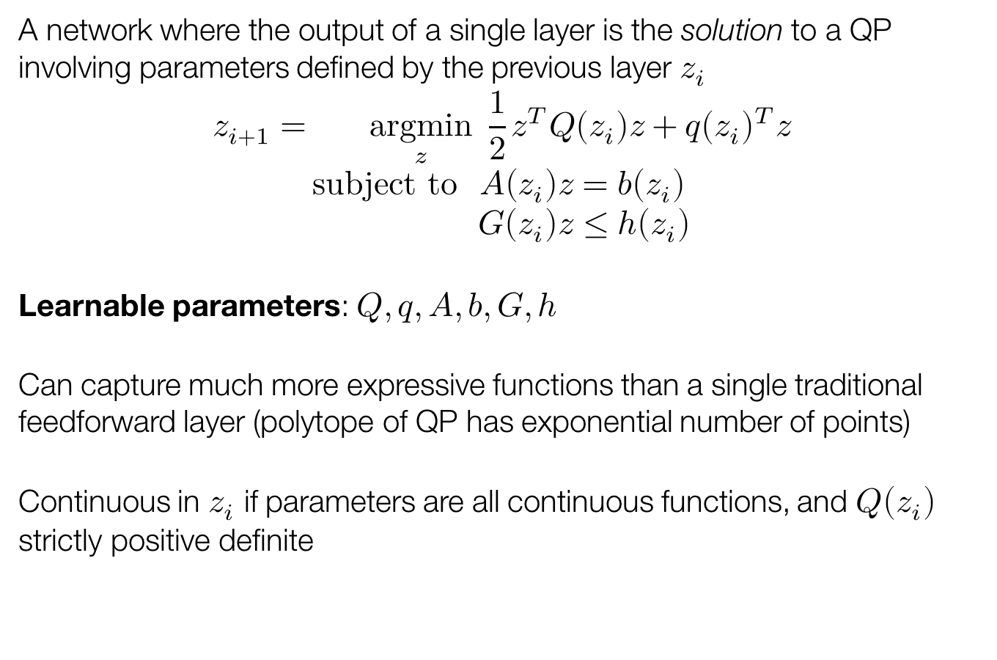
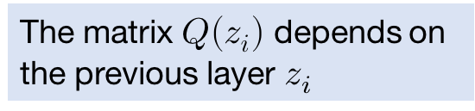
Our Contribution: The OptNet Approach
A network where the output of a single layer is the solution to a QP involving parameters defined by the previous layer $z_{i}$
$$z_{i+1}=\underset{z}{argmin}{\frac{1}{2}z^{T}Q\left(z_{i}\right)z+q{\left(z_{i}\right)}^{T}z} \\ subject to A\left(z_{i}\right)z=b\left(z_{i}\right) \\ G\left(z_{i}\right)z≤h\left(z_{i}\right)$$
Learnable parameters: $Q,q,A,b,G,h$
Can capture much more expressive functions than a single traditional feedforward layer (polytope of QP has exponential number of points)
Continuous in $z_{i}$ if parameters are all continuous functions, and $Q\left(z_{i}\right)$ strictly positive definite
The matrix $Q\left(z_{i}\right)$ depends on the previous layer $z_{i}$
Notes:
What do these actually look like?
Give examples of Q(zi), q(zi)
Mention feasibility

Slide 8
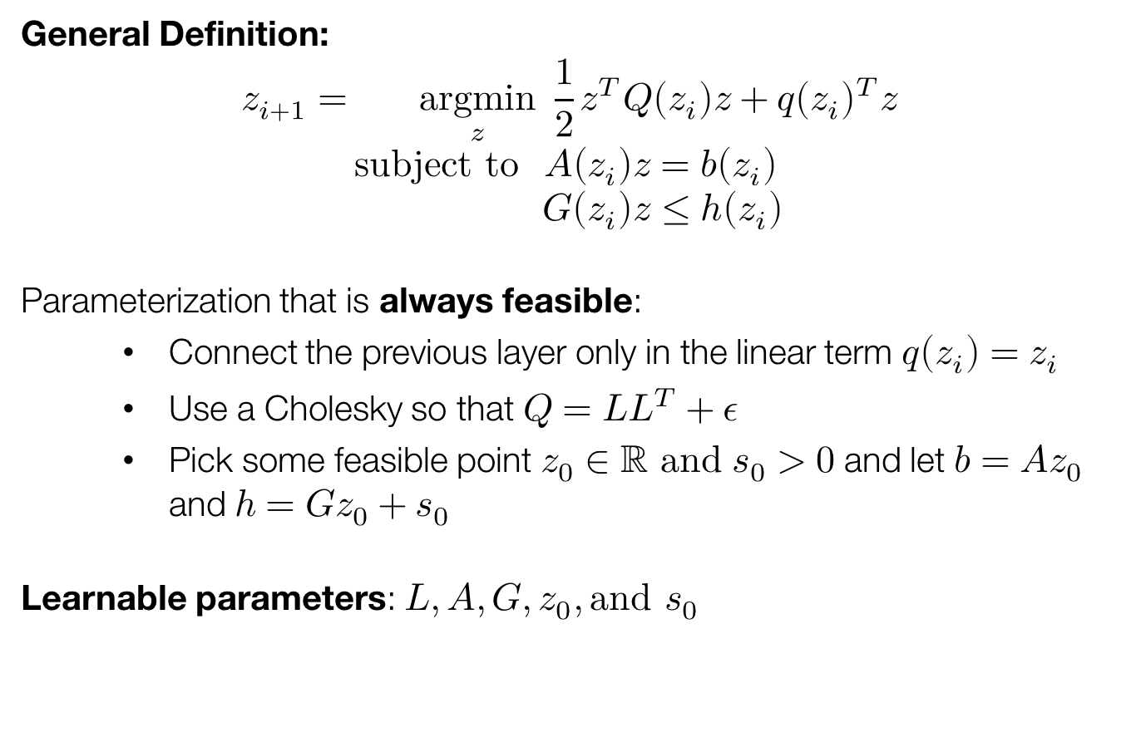
Example OptNet Layer
General Definition:
$$z_{i+1}=\underset{z}{argmin}{\frac{1}{2}z^{T}Q\left(z_{i}\right)z+q{\left(z_{i}\right)}^{T}z} \\ subject to A\left(z_{i}\right)z=b\left(z_{i}\right) \\ G\left(z_{i}\right)z≤h\left(z_{i}\right)$$
Parameterization that is always feasible:
Connect the previous layer only in the linear term $q\left(z_{i}\right)=z_{i}$
Use a Cholesky so that $Q=LL^{T}+ε$
Pick some feasible point $z_{0}∈ℝ and$ $s_{0}>0$ and let $b=Az_{0}$ and $h=Gz_{0}+s_{0}$
Learnable parameters: $L,A,G,z_{0}, \text{and} s_{0}$

Slide 9
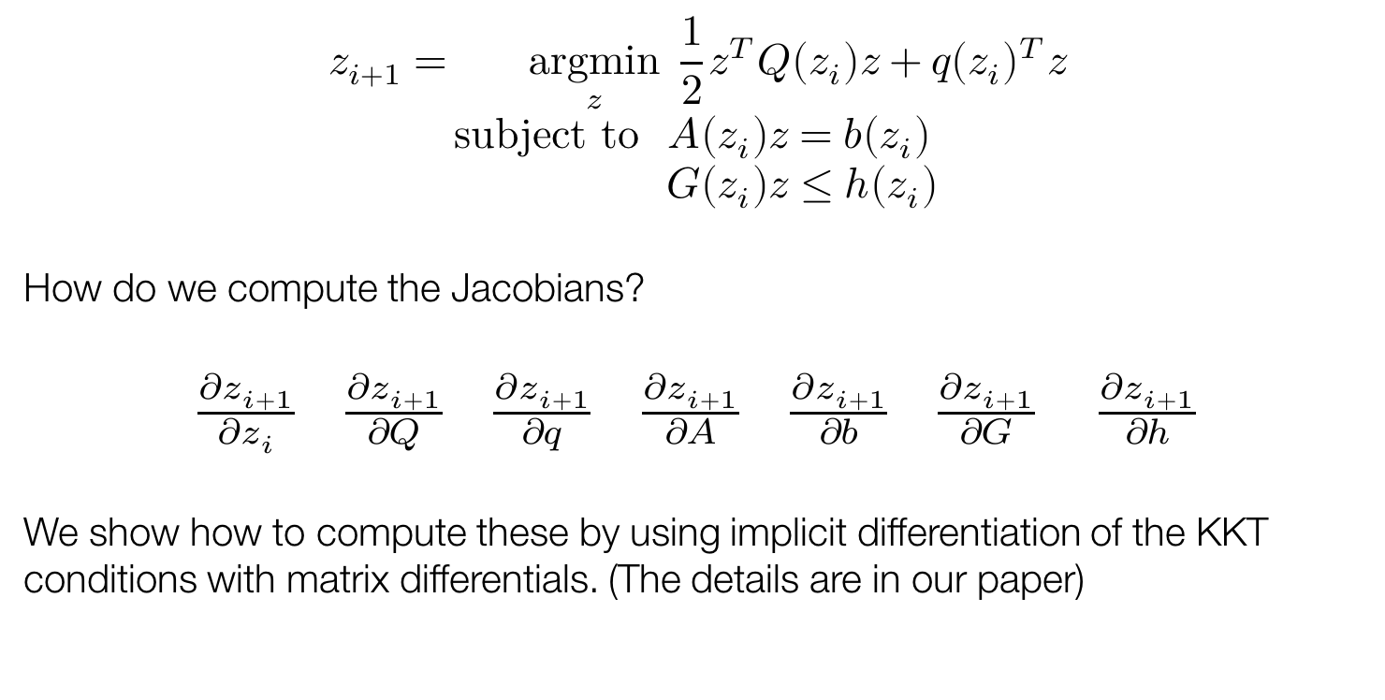
Differentiating through OptNet layers
$$z_{i+1}=\underset{z}{argmin}{\frac{1}{2}z^{T}Q\left(z_{i}\right)z+q{\left(z_{i}\right)}^{T}z} \\ subject to A\left(z_{i}\right)z=b\left(z_{i}\right) \\ G\left(z_{i}\right)z≤h\left(z_{i}\right)$$
How do we compute the Jacobians?
$\frac{∂z_{i+1}}{∂z_{i}}$ $\frac{∂z_{i+1}}{∂Q}$ $\frac{∂z_{i+1}}{∂q}$ $\frac{∂z_{i+1}}{∂A}$ $\frac{∂z_{i+1}}{∂b}$ $\frac{∂z_{i+1}}{∂G}$ $\frac{∂z_{i+1}}{∂h}$
We show how to compute these by using implicit differentiation of the KKT conditions with matrix differentials. (The details are in our paper)

Slide 10
Talk Overview
Our contribution: OptNet layers
qpth: Our efficient and differentiable PyTorch QP solver
Experiments
MNIST
1D Signal Denoising
Mini-Sudoku

Slide 11
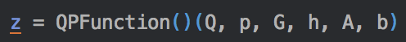
qpth: Our efficient and differentiable PyTorch QP solver
OptNet formulation is slow compared to Linear+ReLU layers, even with highly optimized solvers
We implemented our own primal-dual interior point algorithm for QPs, specialized for minibatch processing of multiple same-sized problems using batch GPU factorization, plus some additional tricks
Nice property: We can backprop through the solver effectively “for free”
Our open source PyTorch library is available at http://locuslab.github.io/qpth
Add a differentiable QP OptNet layer to your PyTorch models with one line of code with our PyTorch Function after defining the parameters:

Slide 12
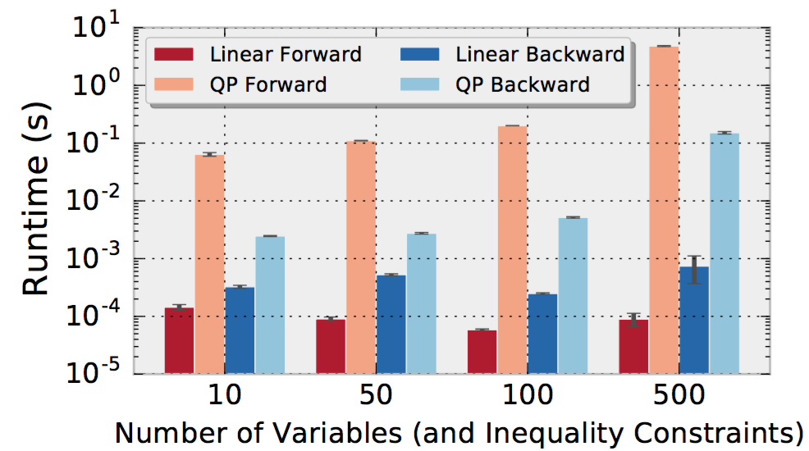
Timing Results: Comparison to a linear layer
OptNet layers are more expensive but still tractable
Notes:
Group by model, qpfb, linearfb

Slide 13
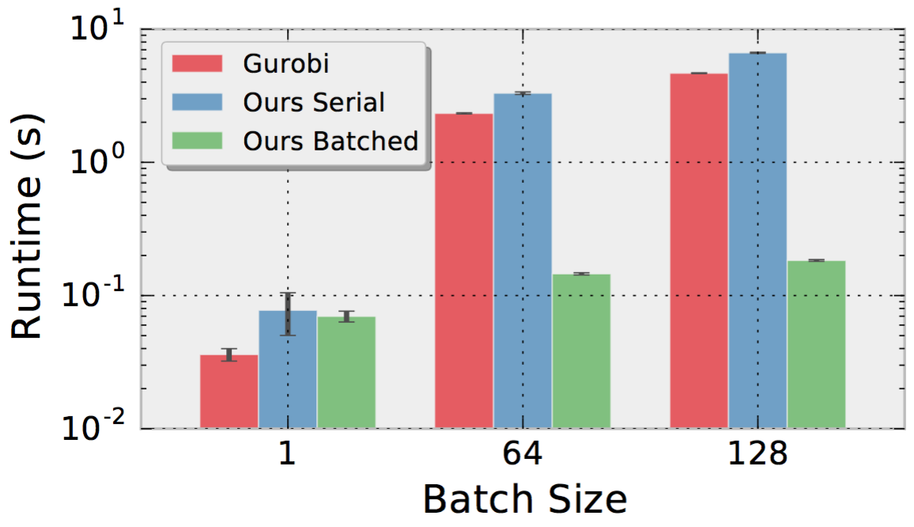
Timing Results: Comparison to Gurobi
Batched QP solvers are crucial for tractability

Slide 14
Talk Overview
Our contribution: OptNet layers
qpth: Our efficient and differentiable PyTorch QP solver
Experiments
MNIST
1D Signal Denoising
Mini-Sudoku

Slide 15
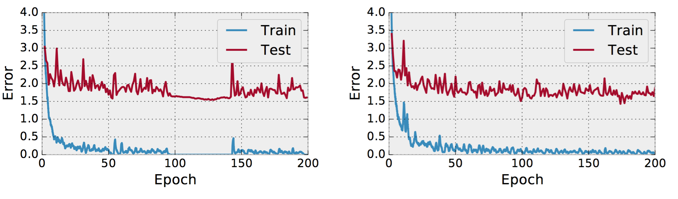
Results: MNIST
Only interesting as a sanity check and to show that an OptNet layer can be added as a layer without harming the training process.
FC600-FC10-FC10-Softmax
FC600-FC10-Optnet10-Softmax

Slide 16
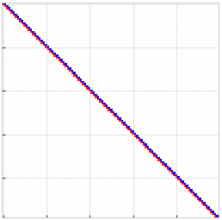
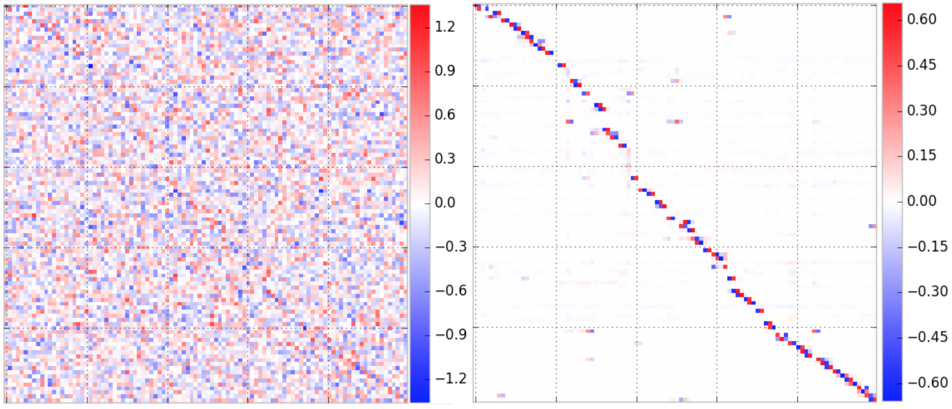
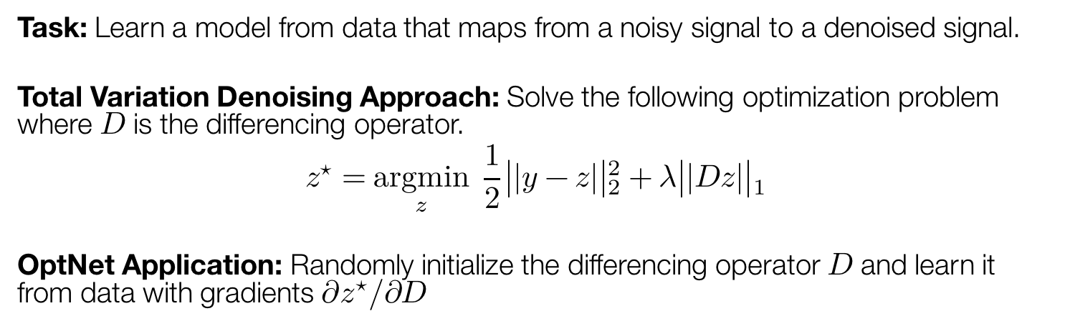
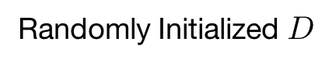
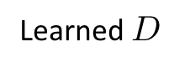
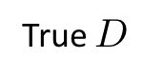
Results: 1D Signal Denoising
Task: Learn a model from data that maps from a noisy signal to a denoised signal.
Total Variation Denoising Approach: Solve the following optimization problem where $D$ is the differencing operator.
$$z^{⋆}=\underset{z}{argmin}{\frac{1}{2}{\left|\left|y−z\right|\right|}_{2}^{2}+λ{\left|\left|Dz\right|\right|}_{1}}$$
OptNet Application: Randomly initialize the differencing operator $D$ and learn it from data with gradients $∂z^{⋆}/∂D$
True $D$
Randomly Initialized $D$
Learned $D$
Notes:
Clarify problem setup
Show true D operator

Slide 17
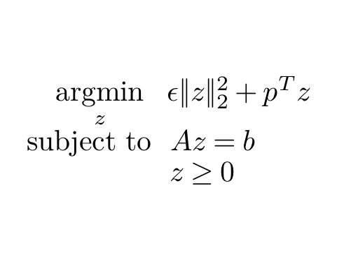
Results: Mini-Sudoku
Sudoku can be posed as a constraint-satisfaction optimization problem
Every row should contain the digits 1-4
Every column should contain the digits 1-4
Every partitioned sub-block should contain the digits 1-4
Task: Learn a model from data that maps from unsolved boards to solved boards.
The OptNet Approach:
Example input/output pair:
$$\underset{z}{argmin}{ε{\left\|z\right\|}_{2}^{2}}+p^{T}z \\ subject to Az=b \\ z≥0$$
One-hot encoding of unsolved puzzle
Arbitrary parameters

Slide 18
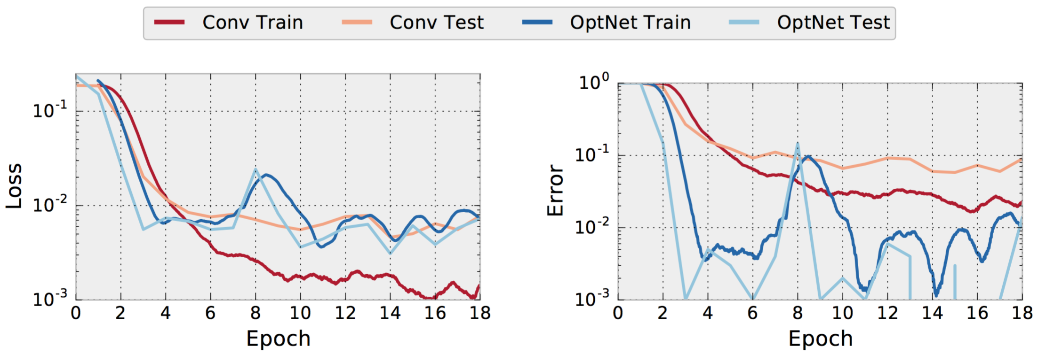
Results: Mini-Sudoku
The OptNet layer exactly learns the mini-Sudoku constraints from data!
Baseline: A deep convolutional feed-forward network
MSE
% Incorrectly Solved Boards
Convolutional network: Significant train/test gap
OptNet: Small gap, generalizes well
Notes:
+ Define loss/error

Slide 19
OptNet: Differentiable Optimization as a Layer in Neural Networks
Brandon Amos and J. Zico Kolter Carnegie Mellon University School of Computer Science
@brandondamos
@zicokolter
Our contribution: OptNet layers
qpth: Our efficient and differentiable PyTorch QP solver
Experiments
MNIST
1D Signal Denoising
Mini-Sudoku
The full PyTorch source code to reproduce all of our experiments is available online at https://github.com/locuslab/optnet
Our PyTorch QP solver is freely available online at https://locuslab.github.io/qpth

